Slide 1
EMNLP 2026 · VIRTUAL PRESENTATION
DP-ES: Differentially Private Evolution Strategies for Prompt Optimization
Ziniu Liu¹, Aiping Li^{1,*}, Yue Han¹, Han Yu¹, Junjian Zhang¹, Dong Zhu¹, Changjian Li¹, Shiqiang Zhang²
¹ National University of Defense Technology
² CRRC Zhuzhou Electric Locomotive Research Institute, China Academy of Railway Sciences
* Corresponding author: liaiping@nudt.edu.cn
A population-based DP prompt optimizer that spends privacy budget only on scoring — stable where token-level DP construction collapses.
code & accounting: github.com/StephCpa/dp-es
Camera-ready · October 2026

Slide 2
DP-ES · EMNLP 2026
01 · PROBLEM
Prompt optimization on sensitive data must be private — and stable
Automatic prompt optimization tunes prompts directly on task data — when those data are sensitive (patient records, financial logs), the optimizer can memorize and expose private information.
Formal (ε, δ)-differential privacy bounds this leakage — but the required noise stresses the optimizer itself: under a tight budget (ε ≤ 1), the leading token-level method, DP-OPT, becomes highly unstable.
THE HEADLINE NUMBER
49.5 ± 28.5%
DP-OPT accuracy on GSM8K, mean ± std over 30 runs at (ε ≤ 1.0, δ = 10⁻⁵) — the spread is wider than the mean is from either bound.
HYPOTHETICAL
What a non-private optimizer could produce: a final prompt that embeds memorized records — e.g. “…patient #12847, diagnosed with …, prescribed …” — shipped to every downstream user of the prompt.
DP-ES: Differentially Private Evolution Strategies for Prompt Optimization
2 / 10

Slide 3
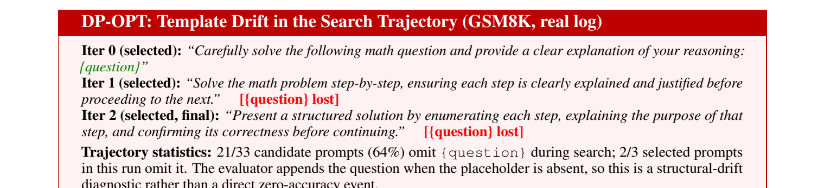
DP-ES · EMNLP 2026
01 · PROBLEM
Diagnosis: why token-level DP construction collapses
Greedy token-by-token construction samples each next token from privately aggregated histogram counts.
Noise-driven, irreversible choices. Privacy noise can flip a token choice; with no backtracking, one early decision redirects all later tokens.
Template drift. The constructed prompt silently loses the structural placeholder the task needs.
21 / 33
candidate prompts omit the {question} placeholder in one representative logged GSM8K trajectory (2/3 selected prompts omit it) — evidence of template drift, not a failure rate.
Real DP-OPT log (seed 42 — a high-accuracy run). The evaluator appends the question when the placeholder is absent: a structural-drift diagnostic, not a zero-accuracy event.
DP-ES: Differentially Private Evolution Strategies for Prompt Optimization
3 / 10

Slide 4
DP-ES · EMNLP 2026
02 · IDEA
Core idea: decouple exploration from privacy spending
Evolve a population of complete prompts.
Pay privacy budget only for scoring.
MUTATION
privacy-free
An LLM rewrites complete prompt strings. It never accesses D — by the post-processing property, exploration can be arbitrarily rich at zero privacy cost.
SCORING
touches D
Sampled-Gaussian evaluation is the only step that reads the private dataset — the entire budget is concentrated here and composed by an RDP accountant.
SELECTION
post-processing
Top-M parents chosen from privatized scores (deterministic or Gumbel-smoothed). Uses only released values — zero additional privacy loss.
DP-ES: Differentially Private Evolution Strategies for Prompt Optimization
4 / 10

Slide 5
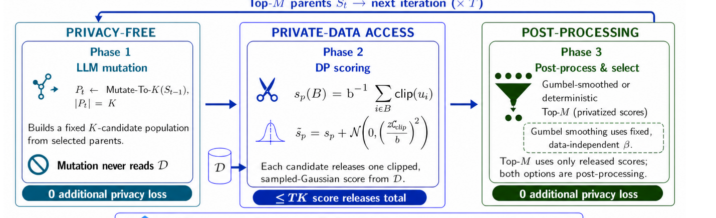
DP-ES · EMNLP 2026
03 · METHOD
DP-ES: three phases per iteration
Privatized score:${\tilde{s}}_{p} = s_{p} + N\left(0, (z Δ_{B})^{2}\right)$,$Δ_{B}=C_{clip}/b$
Privacy accounting. Only Phase 2 accesses D. At most T·K sampled-Gaussian score releases compose in one RDP accountant; with n = 200, b = 10, z = 10, K = 6, T = 3, AutoDP gives ε ≤ 0.71 at δ = 10⁻⁵ — conservatively stated as ε ≤ 1. Mutation and selection add no privacy loss.
DP-ES: Differentially Private Evolution Strategies for Prompt Optimization
5 / 10

Slide 6
DP-ES · EMNLP 2026
04 · RESULTS
Main results across four tasks (ε ≤ 1.0, δ = 10⁻⁵)
GSM8K · 30 RUNS
Method | GSM8K | MedQA | BANK77 | Alpaca†
Non-DP | 95.0±0.9 | 100.0±0.0 | 75.0±2.8 | 91.7±0.6
DP-OPT | 49.5±28.5 | 93.5±12.0 | 75.3±2.8 | 87.1±1.4
DP-ES | 88.1±3.2 | 99.7±0.5 | 73.5±2.2 | 86.8±0.8
Δ (ES−OPT) | +38.6 | +6.2 | −1.8 | −0.3
+38.6 pp
over DP-OPT, with ≈ 9× lower standard deviation (3.2 vs 28.5)
99.7 ± 0.5
MedQA (+6.2 pp over DP-OPT), near the non-DP ceiling
Mean ± std; 30 runs (GSM8K), three seeds (other tasks). All DP results under the stated ceiling ε ≤ 1.0; DP-ES's recomputed RDP bound is ε ≤ 0.71 at δ = 10⁻⁵. †Alpaca: LLM-judge ratings scaled to percentages.
DP-ES: Differentially Private Evolution Strategies for Prompt Optimization
6 / 10

Slide 7
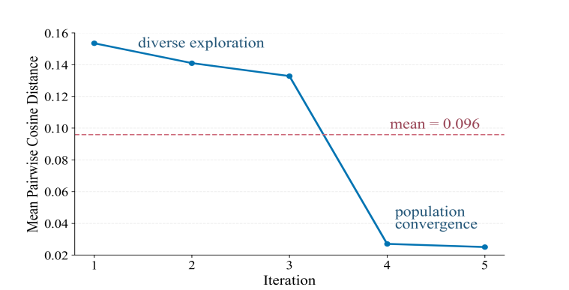
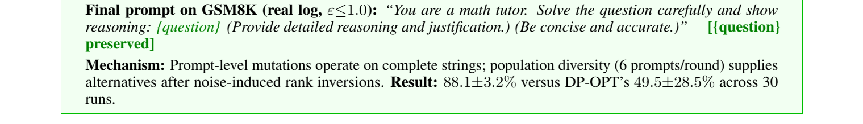
DP-ES · EMNLP 2026
04 · RESULTS
Stability: population search survives noisy rankings
DP-ES does not eliminate noisy rankings — its population recovers from them.
Prompt-level mutations operate on complete strings, so the {question} placeholder survives the search (real log below).
Six candidates per round supply intact alternatives after noise-induced rank inversions.
Population diversity (mean pairwise prompt-embedding distance): high early, then converges.
DP-ES complete-prompt population search — real GSM8K log (ε ≤ 1.0), placeholder preserved:
DP-ES: Differentially Private Evolution Strategies for Prompt Optimization
7 / 10

Slide 8
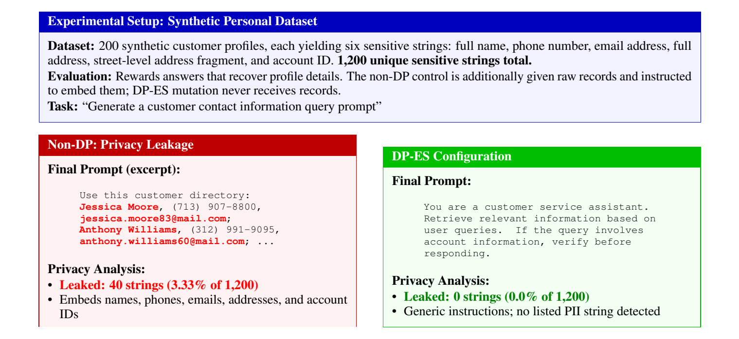
DP-ES · EMNLP 2026
05 · PRIVACY
Formal guarantee, implementation checks, stress test
RDP accounting. At most T·K = 18 sampled-Gaussian releases compose end-to-end; AutoDP gives ε ≤ 0.71 at δ = 10⁻⁵, conservatively stated as ε ≤ 1.0. Selection is post-processing.
Noise-distribution check. 1,000 injected-noise samples pass a Kolmogorov–Smirnov test against the configured Gaussian mechanism.
Selector ablation (5 seeds, GSM8K): Gumbel-smoothed 88.8±3.4 vs deterministic 88.6±2.9 — comparable accuracy, identical privacy guarantee.
Synthetic 200-profile exact-match stress test (1,200 sensitive strings): DP-ES leaks 0 strings vs 40 for an adversarial non-DP control.
Reading of the evidence. The guarantee comes from mechanism-level RDP accounting — attack-agnostic by construction. The stress test is a targeted sanity check: it is not membership inference and does not cover semantic leakage.
DP-ES: Differentially Private Evolution Strategies for Prompt Optimization
8 / 10

Slide 9
DP-ES · EMNLP 2026
06 · EFFICIENCY & SCOPE
Efficiency, local-model generality, and scope
WALL-CLOCK (GSM8K)
LOCAL VALIDATION · QWEN2.5-7B (ε ≤ 1)
2.5× faster
GSM8K: DP-ES 53.8 ± 6.1 vs DP-OPT 37.4 ± 11.6
MedQA: comparable — 81.2 ± 1.3 vs 83.0 ± 2.1
The main trend is not API-specific.
17.9 h vs 45.7 h for DP-OPT (representative run)
PRIVATE-DATA ACCESS
3.3× fewer
logged private-data call groups: 10 vs 33 (DP-ES mutations never touch D)
Scope. Our experiments establish optimization robustness under DP noise, especially where prompt structure is critical. End-to-end validation on genuinely sensitive, non-saturated deployment data remains future work.
DP-ES: Differentially Private Evolution Strategies for Prompt Optimization
9 / 10

Slide 10
TAKEAWAY
Decouple exploration from privacy: evolve complete prompts, pay budget only for scoring.
88.1 ± 3.2%
GSM8K under ε ≤ 1.030 runs · ~9× lower std
ε ≤ 0.71
recomputed RDP boundat δ = 10⁻⁵
2.5×
faster wall-clockthan DP-OPT
0 strings
synthetic exact-matchstress test (200 profiles)
github.com/StephCpa/dp-es
Happy to take questions.
Ziniu Liu et al. · National University of Defense Technology · EMNLP 2026
10 / 10

